Slide 1
Classification of room occupancy
MPA-MLF - Final project
Roman Lunin
Mark Kovychev

Slide 2
Task Description:
Classify the number of persons in a room based on delay-Doppler images
Classes:
Class 0 → empty room
Class 1 → one person
Class 2 → two persons
Class 3 → three persons
Goal:
achieve the highest possible accuracy

Slide 3
Solution
1. Loading and preprocessing data:
mapping IDs to image paths (id + 1)
normalization of input images
2. Handling class imbalance:
inverse class weights
Higher importance for class 3
3. Data augmentation:
small transformations (shift, scale, color)
improved generalization
4. Model
EfficientNet-B1 (pretrained)
adapted for 4 classes
5. Training strategy
5-fold cross-validation
stable performance across the dataset
6. Final prediction
ensemble of 10 models
test-time augmentation (TTA)

Slide 4
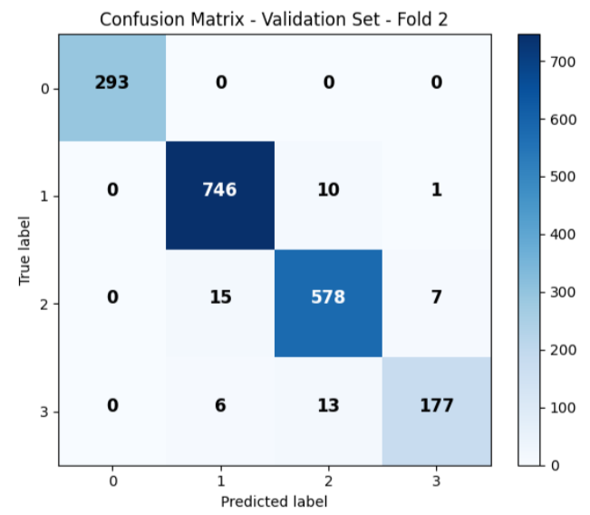
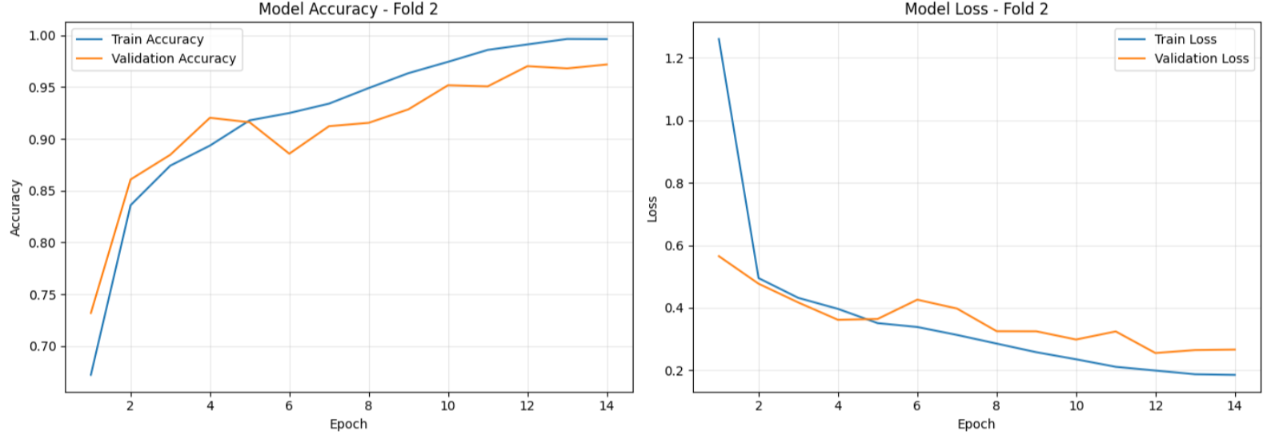
Results:
The best accuracy is 97.291%
The Kaggle score is 0.97667

Slide 5
Thank you for your attention!!!

